Slide 1

New Feature Review
DYNAMICS 365

Slide 2

Mitch Milam
Dynamics CRM Architect
mitch@xrmcoaches.com
@mitchmilam
http://tinyurl.com/MitchMilamLinkedIn

Slide 3
Future Events
Webinar: Using Microsoft Flow with Dynamics 365
In this webinar we will introduce you to using Microsoft Flow with Dynamics 365.
Fri, Jan 27, 2017 10:00 AM - 11:00 AM CST
Webinar: Dynamics 365: Business Rules Revisited
With the changes to the Business Rule Designer introduced in Dynamics 365, I thought it would be a good idea to revisit the creation and use of Business Rules for Dynamics 365.
Fri, Feb 3, 2017 10:00 AM - 11:00 AM CST

Slide 4
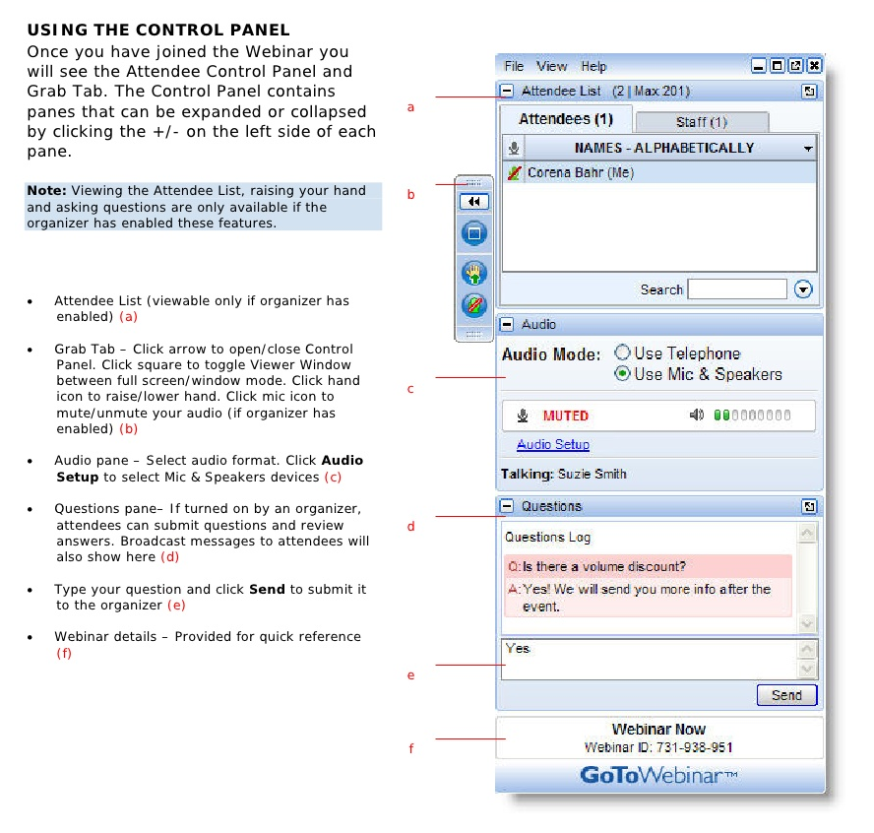
Webinar Housekeeping

Slide 5



2017 Training Roadmap
Webinars
http://www.xrmcoaches.com/webinars
KnowledgeBits
http://www.xrmcoaches.com/knowledgebits
Learning Plans
http://www.xrmcoaches.com/freestuff
More Goodies
Practice tests
On–Demand video training
Instructor–led training
Books

Slide 6
Agenda
.

Slide 7
Modular Business Apps
Role-Based
Sales
Customer Service
Field Service
Project Service Automation
App Designer
Site-Map Editor

Slide 8
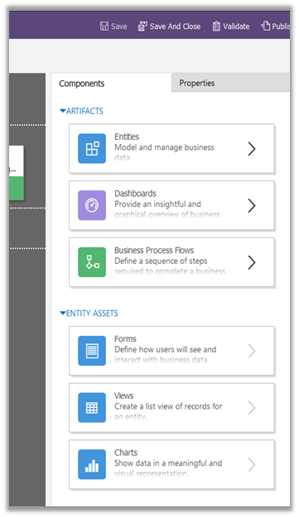
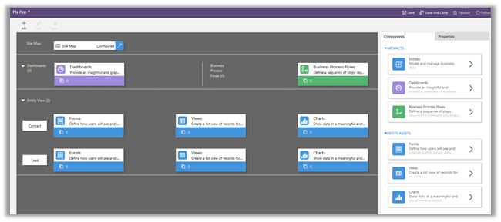
App Designer

Slide 9
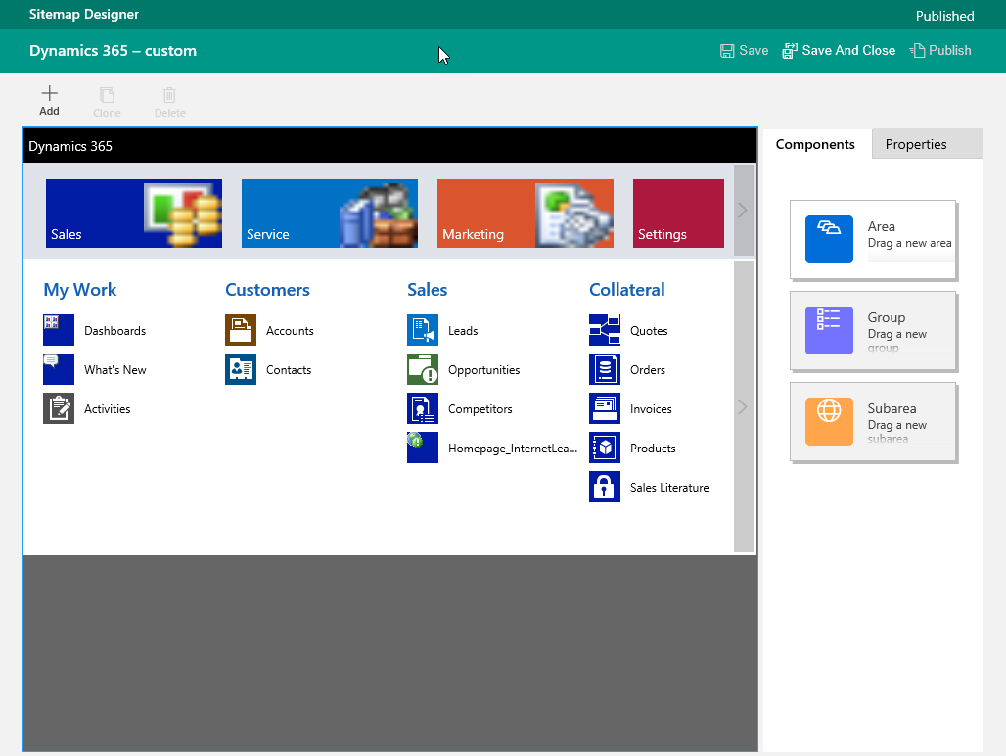
Site Map Designer

Slide 10
Portal Enhancements
Multi-language portal support
Faceted search for knowledge articles
Content access levels for knowledge articles
Project Service Automation integration
Field Service integration
Multi-partner collaboration
Partner onboarding and recruitment:
Partner locator
Partner portal dashboard
Deal registration and protection

Slide 11
Display the Associated Activities
The primary and the related entity must be a 1:N (one-to-many) or N:1 (many-to-one) custom relationship.
The flag can’t be set on any out-of-the-box system relationships.
The primary entity for the relationship must be Account, Contact, or Opportunity.
The related entity must support Activities.
Notes:
This is because these are the only entity forms in the system where the Activity Associated View appears. You can’t specify any other primary entity for activity rollups.

Slide 12
Power BI Integration Enhancements
New Service Content Pack includes several key service indicators:
Cases created
Cases resolved
Satisfaction percentage
Top agent leaders
Most used and viewed KB articles.
Sales Manager Content Pack includes OData (Open Data Protocol) version 4.0 support.
Embed Power BI tiles directly from a CRM user dashboard without having to switch to the Power BI service.

Slide 13
Mobile App Enhancements
New layouts
Multimedia content
Enhanced sync filter
JavaScript Support
Web Resources Support

Slide 14
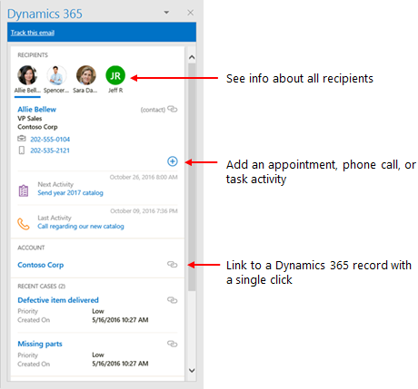
App for Outlook Enhancements

Slide 15
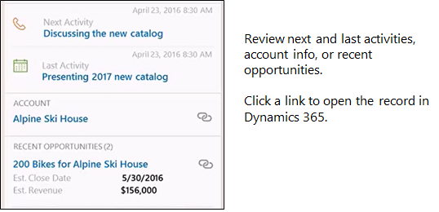
App for Outlook Enhancements

Slide 16
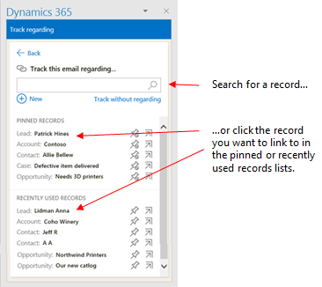
App for Outlook Enhancements

Slide 17
Learning Path Authoring
Create your own guided help

Slide 18
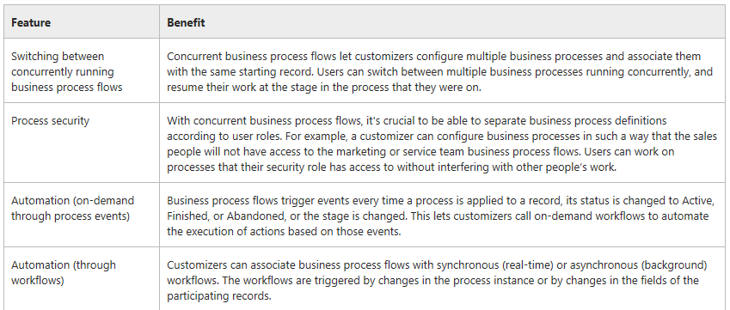
Processes Unification and Enhancements

Slide 19
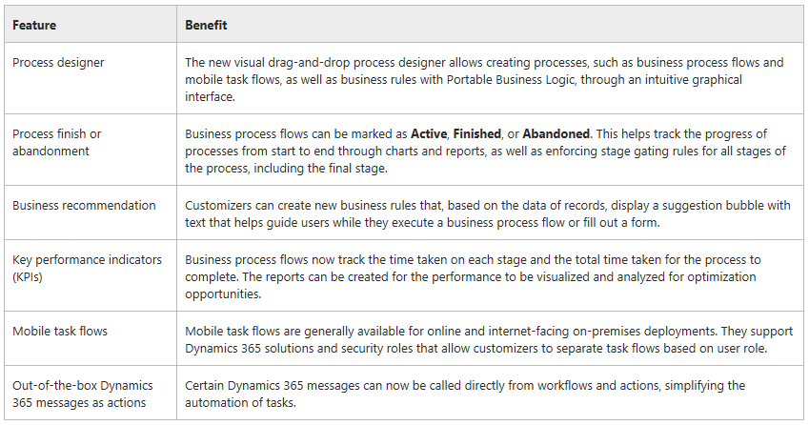
Processes Unification and Enhancements

Slide 20
Interactive Service Hub Enhancements
USD Support
Add iFrames and web resources to forms
Configure the lookup field properties to show filtered records
Configure language filters in the Knowledge Article Search pane
Add the SLA timer to the Main interactive experience form

Slide 21
Field Service Enhancements
Connected Field Service
Resource scheduling optimization
Common scheduling experience

Slide 22
Project Service Automation Enhancements
Add-in for Microsoft Project
Consolidated calendar view
Copy functionality
Estimated tax amount field

Slide 23
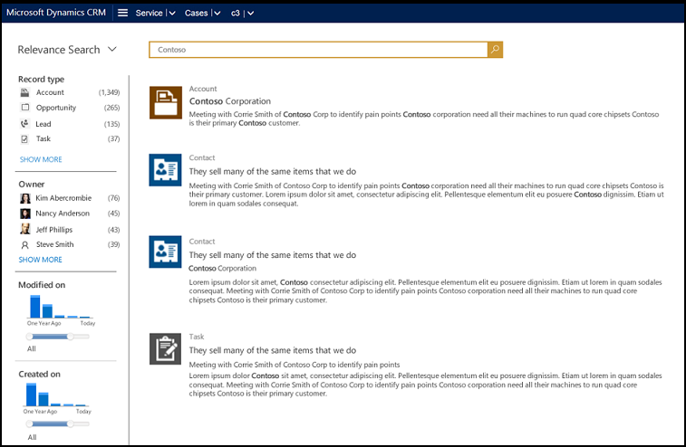
Relevance Search Enhancements
Notes:
new facet and filter support

Slide 24
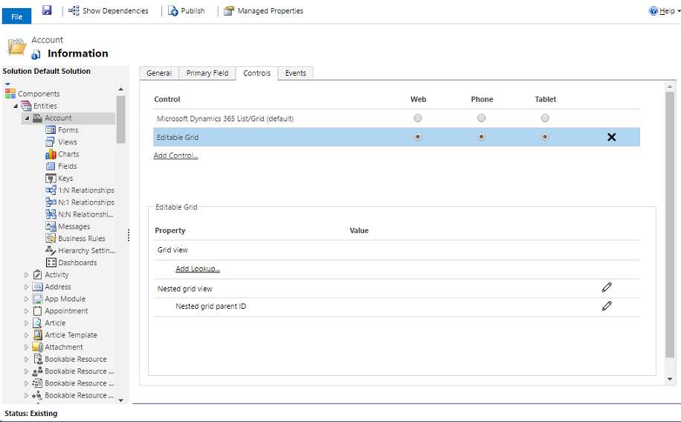
Editable Grids

Slide 25
Office 365 Groups Enhancements
Show guest presence
Ability to associate or disassociate an existing Office 365 Group with an entity record
Adding a project team member will automatically add the user as a member of the Office 365 Group

Slide 26
Customer-Initiated Backup and Restore
System Backups
All your instances are backed up.
System backups occur daily.
System backups are retained for up to three days. Check your expiration date.
System backups do not count against your storage limits.

Slide 27
Customer-Initiated Backup and Restore
On-Demand Backups
You can back up Production and Sandbox instances.
You can only restore to a Sandbox instance. To restore to a Production instance, first switch to a Sandbox instance.
On-demand backups are retained for up to three days. Check your expiration date.
Only CRM Online 2016 Update 1 or later versions are supported for backup.

Slide 28
Microsoft Azure SQL Database using Data Export
Replicate Microsoft Dynamics 365 (online) data to Microsoft Azure SQL Database using Data Export

Slide 29
Access Restriction with Trusted IP Rules
You can limit access to Dynamics 365 (online) to users with trusted IP addresses to reduce unauthorized access
When trusted IP address restrictions are set in a user’s profile and the user tries to log in from an untrusted IP address, access to Dynamics 365 (online) is blocked.

Slide 30
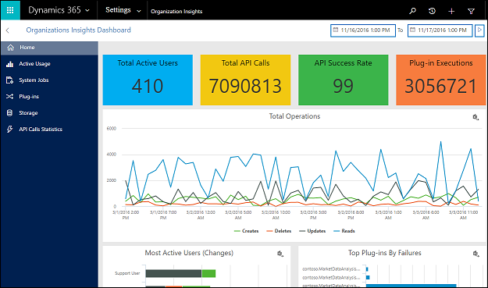
Organizational Insights

Slide 31
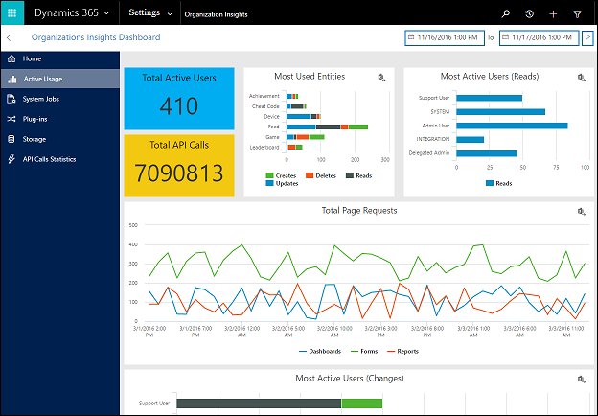
Organizational Insights: Active Usage

Slide 32
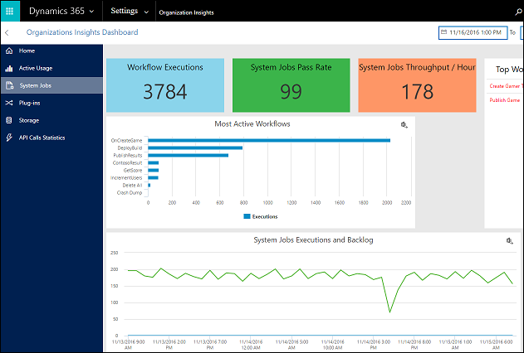
Organizational Insights: System Jobs

Slide 33
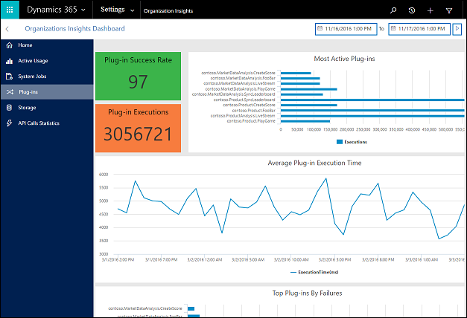
Organizational Insights: Plug-Ins

Slide 34
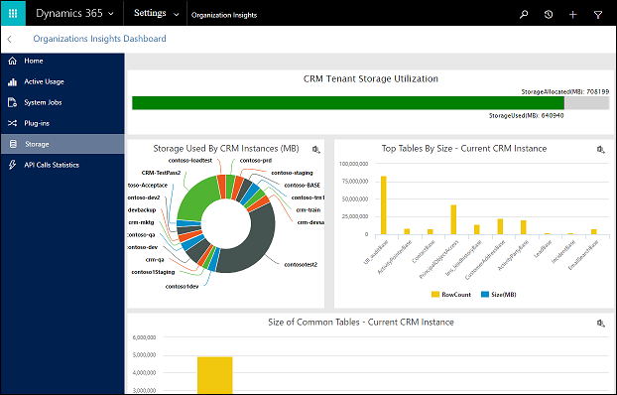
Organizational Insights: Storage

Slide 35
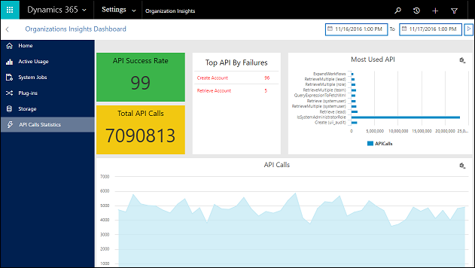
Organizational Insights: API Call Statistics

Slide 36
Azure Cognitive Service integration (Preview)
Create and manage models to make product recommendations
Automatically suggest knowledge articles
Topic analysis
Suggest similar cases for a case
Enable document suggestions

Slide 37
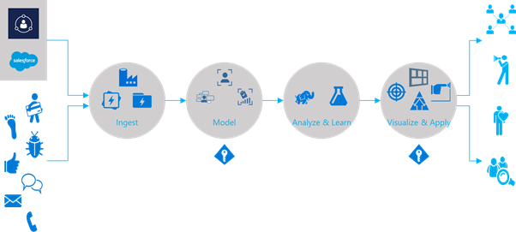
Customer Insights (Preview)

Slide 38
Relationship Insights (Preview)
Relationship assistant
Email engagement
Auto capture

Slide 39
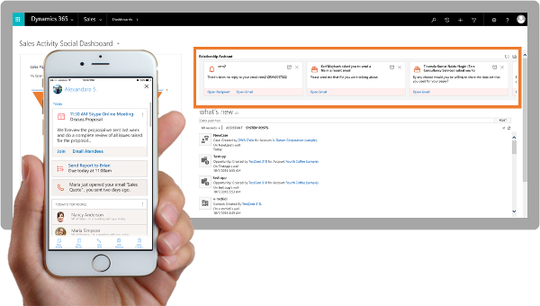
Relationship Insights: Relationship Assistant

Slide 40
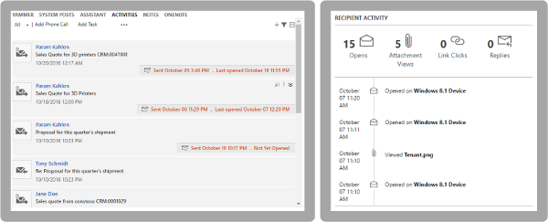
Relationship Insights: Email Engagement

Slide 41
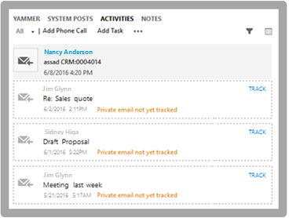
Relationship Insights: Auto Capture

Slide 42
Questions?

Slide 43
Thank You

